Slide 1
Computational Thinking

Slide 2
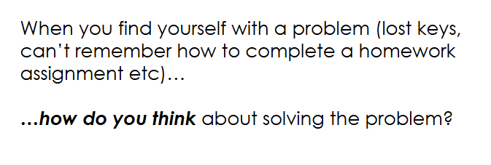
Starter - 3 mins

Slide 3
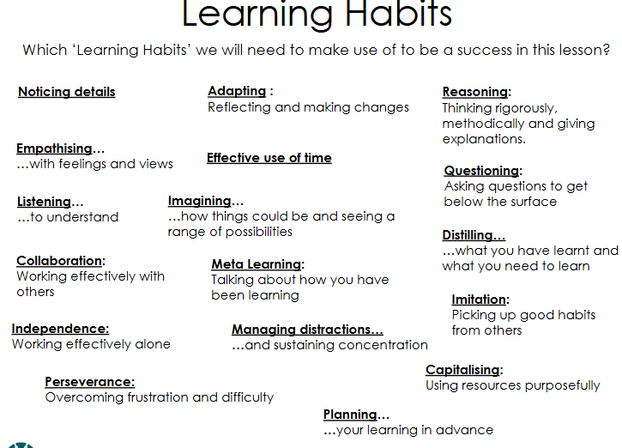

Slide 4
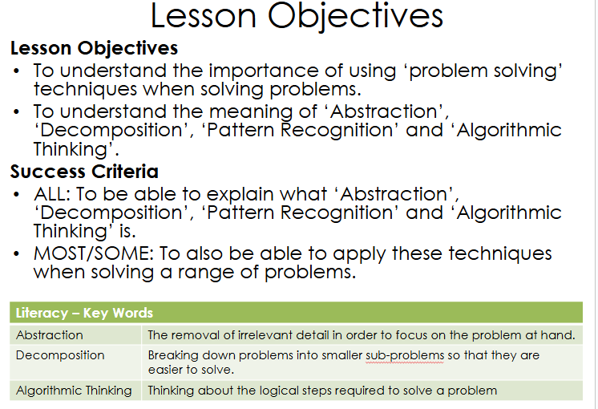

Slide 5
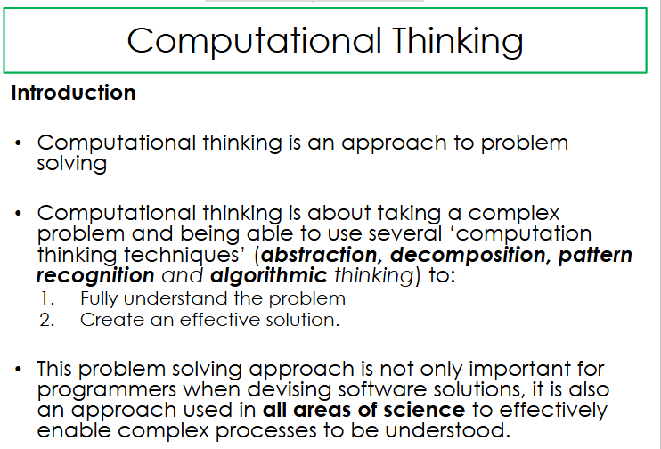

Slide 6
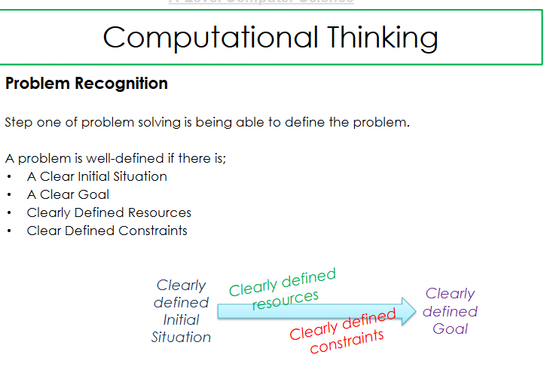

Slide 7
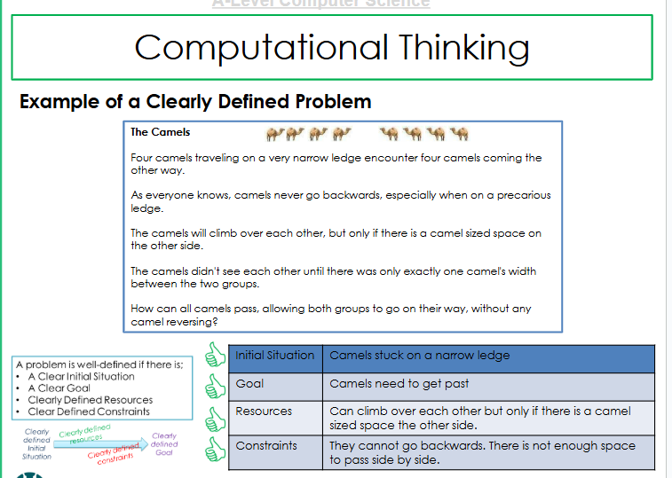

Slide 8
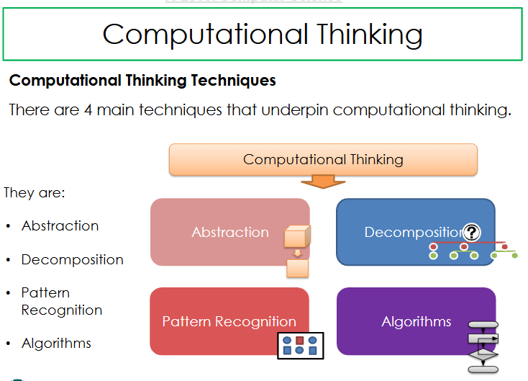

Slide 9
Research Task - 20 mins
Research and Explain types of computational thinking methods with help of any real life example

